Slide 1
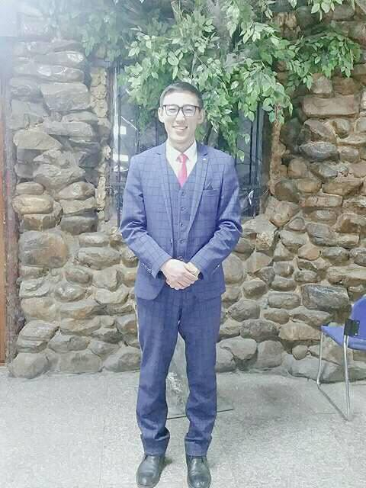
My brother
He is Ulaankhuu. The brother is medium height, and thin. He has dark eyes, black hair, and short hair. He is wearing a blue suit, pink tie, glasses, and black shoes. But he wears no glass. This man looks very handsome, doesn’t he?

Slide 2
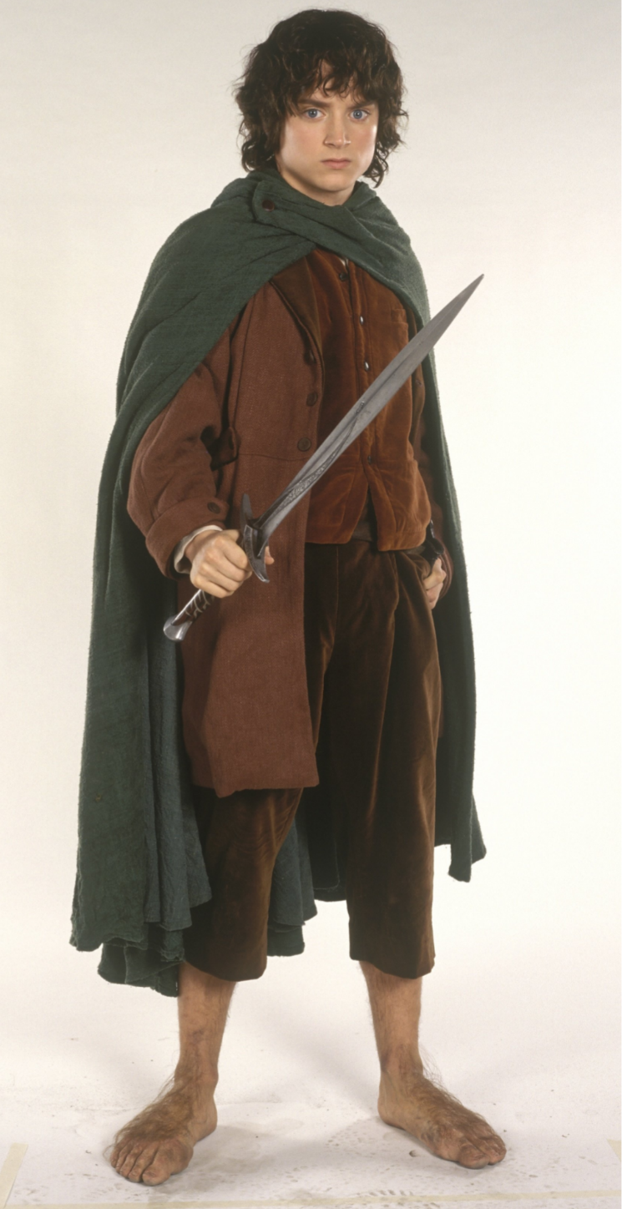
Frodo Baggins
Frodo Baggins, a Hobbit, is small, brave and honest, with bright eyes, curly brown hair and very large hairy feet!
His mission is to take the ring to Mordor where it will be destroyed.
He travels with some friends and together they have to face many dangers. Gandalf a wise wizard, protect them and shows them the way.

